Slide 1
Features
Rayid Ghani
Slides liberally borrowed and customized from lots of excellent online sources

Slide 2
Tabular vs non-tabular data
Structured data has some pre-existing features
Video, Audio, Text, etc. need to have features extracted first.
We’ll talk about structured data today.

Slide 3
What we’ll cover today
Feature Creation/Engineering
Feature Selection [not going to cover]

Slide 4
Why do we care?
Features are hints you give your model
Feature generation has the most impact on your model’s performance
Complexity in features allows us to use less complex models that are faster to run, easier to understand and easier to maintain.

Slide 5
Feature Generation
Categorical to Binary (Dummies)
Features for missing values
Discretization
Date/Time Features
Scaling/Normalizing
Transformations
Aggregations (space, time, space and time)
Relative (compared to the average…)
Interactions

Slide 6
Feature Generation Process
Come up with Feature ideas
Implement Features
Test Performance in ML Pipeline
Discard/Keep

Slide 7
Raw Features
Demographic for example
Gender
Race
Location
Other common attributes

Slide 8
Categorical to Binary
One vs All (Dummy Variables)
What if there are 1000s of values?
Groups
Presence Vs Absence
Other

Slide 9
Missing Values
Impute (Fill in) missing values based on why you think they may be missing and what you want the model to do with those missing values
Mean/median/mode
Typically, also add binary feature (dummy) for missing vs not missing in case “missingness” is predictive of the outcome

Slide 10
Discretization
Equal width bins
Equal size bins
Entropy-based bins
Domain-Specific bins (infant, KG, Elementary school age, middle school age, etc.)

Slide 11

Feature Scaling
Usually a good idea to scale features to have similar range: [-1,1] or [0,1] for example
Be careful with outliers
Standardize/Normalize
Zero mean and unit variance
Sklearn.preprocessing.normalize

Slide 12
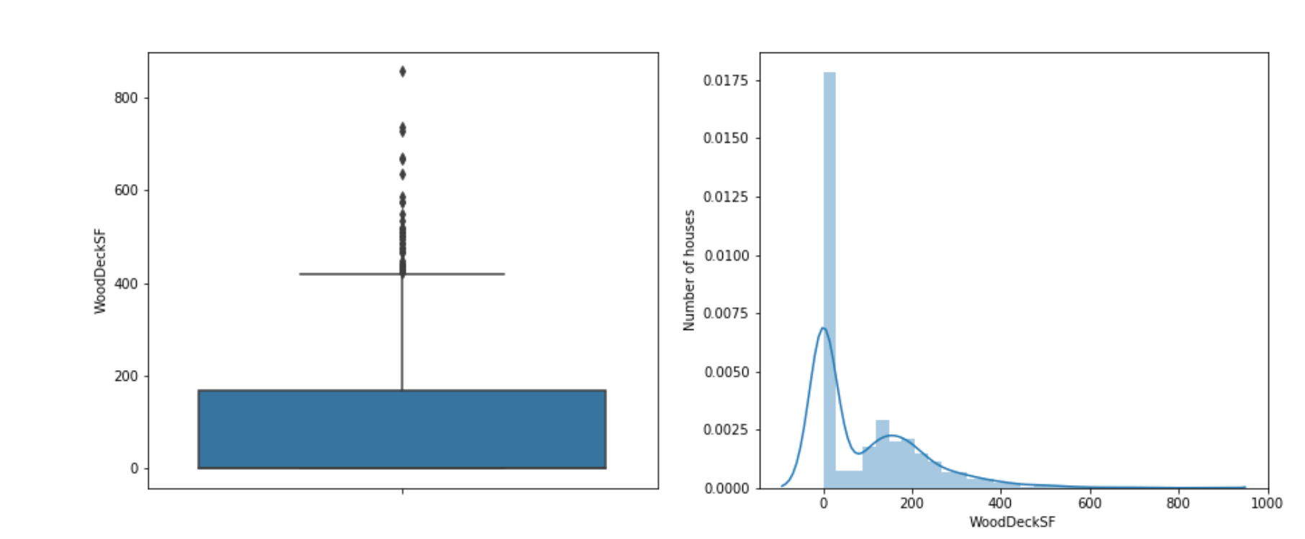
Dealing with Outliers
Use Boxplots to find them
Top-coding, bottom-coding
Do not remove them (unless it’s a data entry error)

Slide 13
Feature Transformations
Non-linear
Log (decreasing marginal utility)
(Square) Root
Squared

Slide 14
Aggregations
Date differences (# of days since…)
Aggregates over different time periods
Min, max, avg, stdev
Avg spend in the past 3 months
Relative aggregates
1.5x avg spend
Distances
Aggregates over different distances
Seasonality

Slide 15
Feature Interactions
Generate features for combination of features
Age x gender
Allows you to use linear models but still model non linear relationships
Random Forests are one way of discovering useful interactions

Slide 16
Features are also model-dependent
Decision trees may need differences between values (dates, amounts, etc.)
Linear models may need …

Slide 17
Feature Selection
All features may not be useful
Some models may be hurt be too many or noisy features
Feature selection allows you to discard some features
Information Gain

Slide 18
Supervised feature selection
Scoring features:
Mutual information between attribute and class
χ²: independence between attribute and class
Classification accuracy
Domain specific criteria:
E.g. Text:
remove stop-words (and, a, the, …)
Stemming (going → go, Tom’s → Tom, …)
Document frequency

Slide 19
Choosing sets of features
Score each feature
Forward/Backward elimination
Choose the feature with the highest/lowest score
Re-score other features
Repeat
If you have lots of features (like in text)
Just select top K scored features

Slide 20
Unsupervised feature selection
Idea:
Given data points in d-dimensional space,
Project into lower dimensional space while preserving as much information as possible
E.g., find best planar approximation to 3D data
E.g., find best planar approximation to 104D data
In particular, choose projection that minimizes the squared error in reconstructing original data

Slide 21
Dimensionality reduction
Some features may be irrelevant
We want to visualize high dimensional data
“Intrinsic” dimensionality may be smaller than the number of features

Slide 22
PCA Algorithm
PCA algorithm:
1. X ← Create N x d data matrix, with one row vector x_{n} per data point
2. X subtract mean x from each row vector x_{n} in X
3. Σ ← covariance matrix of X
Find eigenvectors and eigenvalues of Σ
PC’s ← the M eigenvectors with largest eigenvalues

Slide 23
Doing PCA in Python
http://sebastianraschka.com/Articles/2014_pca_step_by_step.html

Slide 24
2d Data

Slide 25
Principal Components
1st principal vector
Gives best axis to project
Minimum RMS error
Principal vectors are orthogonal
2nd principal vector

Slide 26
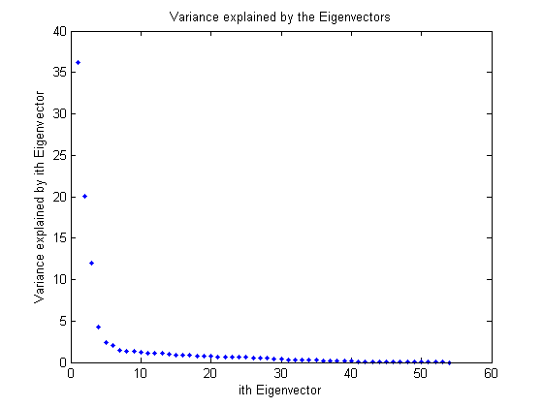
How many components?
Check the distribution of eigen-values
Take enough many eigen-vectors to cover 80-90% of the variance

Slide 27
Problems and limitations
What if very large dimensional data?
e.g., Images (d ≥ 10⁴)
Problem:
Covariance matrix Σ is size (d²)
d=10₄ → |Σ| = 10⁸
Singular Value Decomposition (SVD)!
efficient algorithms available
some implementations find just top N eigenvectors

